Slide 1

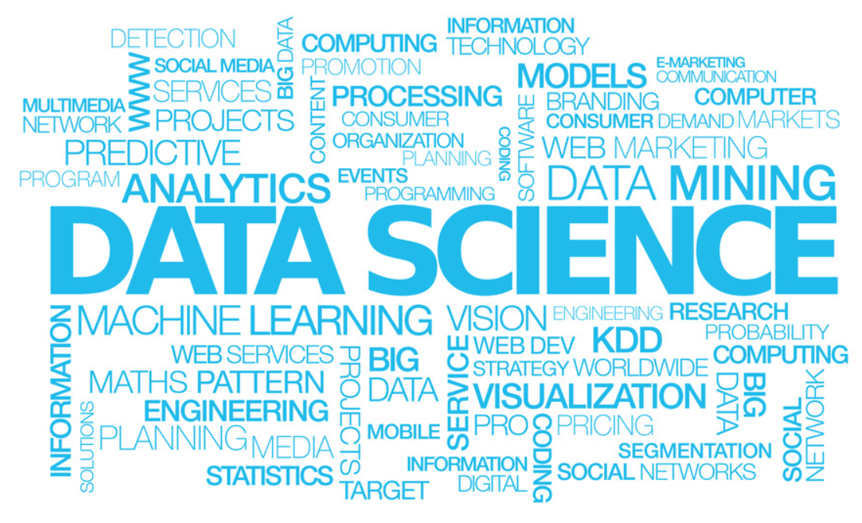
Data Science Big Picture
Author: Prasad Siri
Source: Microsoft

Slide 2
Definition
Data science is an interdisciplinary field about processes and systems to extract knowledge or insights from data in various forms, either structured or unstructured, which is a continuation of some of the data analysis fields such as statistics, machine learning, data mining, and predictive analytics, similar to Knowledge Discovery in Databases (KDD).

Slide 3
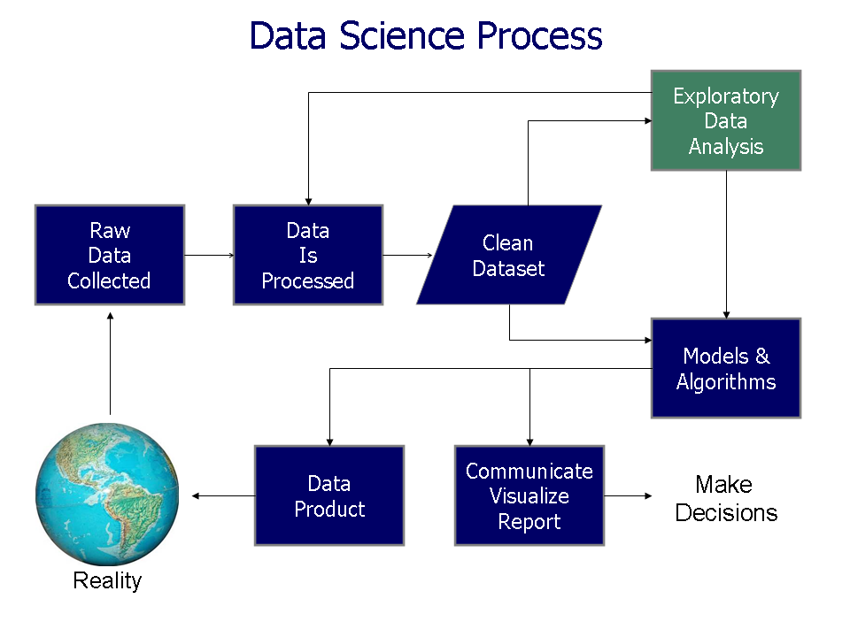
Process
Notes:
In statistics, exploratory data analysis (EDA) is an approach to analyzing data sets to summarize their main characteristics, often with visual methods. Astatistical model can be used or not, but primarily EDA is for seeing what the data can tell us beyond the formal modeling or hypothesis testing task. Exploratory data analysis was promoted by John Tukey
Data used to Benchmark
Data used for Recommendation systems
Data used for Predictions

Slide 4
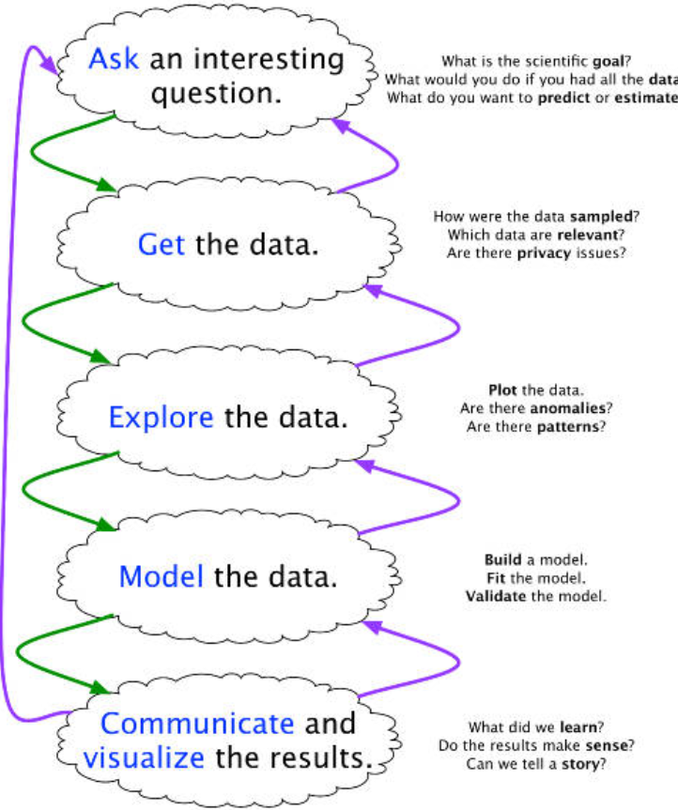
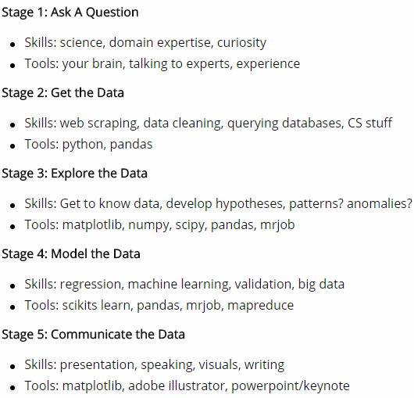
Process
Notes:
In statistics, exploratory data analysis (EDA) is an approach to analyzing data sets to summarize their main characteristics, often with visual methods. Astatistical model can be used or not, but primarily EDA is for seeing what the data can tell us beyond the formal modeling or hypothesis testing task. Exploratory data analysis was promoted by John Tukey
Data used to Benchmark
Data used for Recommendation systems
Data used for Predictions

Slide 5
Prerequisite
little Mathematics
little Statistics
little Programming
More Commonsense
“…the six-foot tall man who drowned crossing the river that was six inches deep on average….”
Notes:
1. The act of persuading (or attempting to persuade); communication intended to induce belief or action
2. A personal belief or judgment that is not founded on proof or certainty

Slide 6
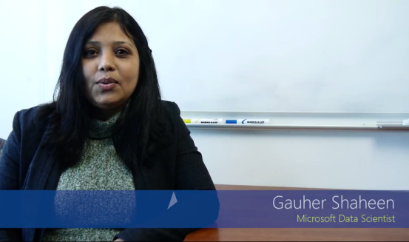
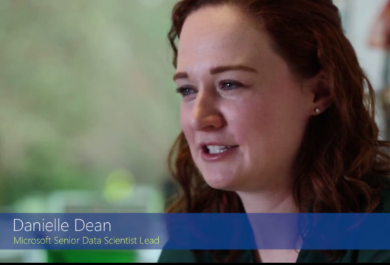
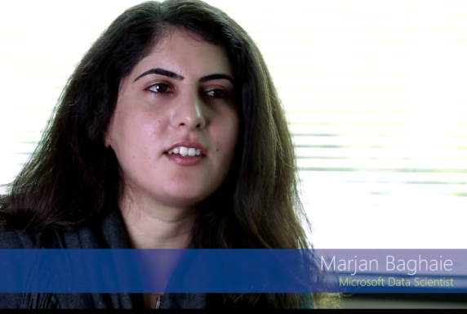
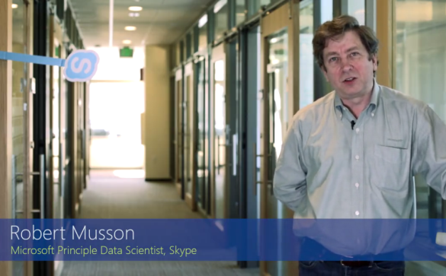
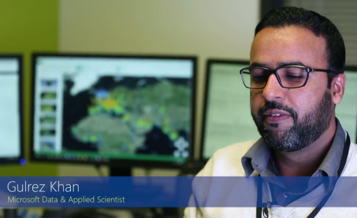
What you enjoy about being a Data Scientist
Gauher Shaheen
Microsoft Data Scientist
Danielle Dean
Microsoft Senior Data Scientist Lead
Marjan Baghaie
Microsoft Data Scientist
Robert Musson
Microsoft Principle Data Scientist, Skype
Gulrez Khan
Microsoft Data & Applied Scientist

Slide 7

What you enjoy about being a Data Scientist

Slide 8
What you enjoy about being a Data Scientist
Problem Solver & Value to the customer
Playing with Data and Making Sense with data
Investigation
Solving Puzzle and New Knowledge
Pattern
Listen carefully … it will talk , User trend , not opinion
Working with Different background

Slide 9
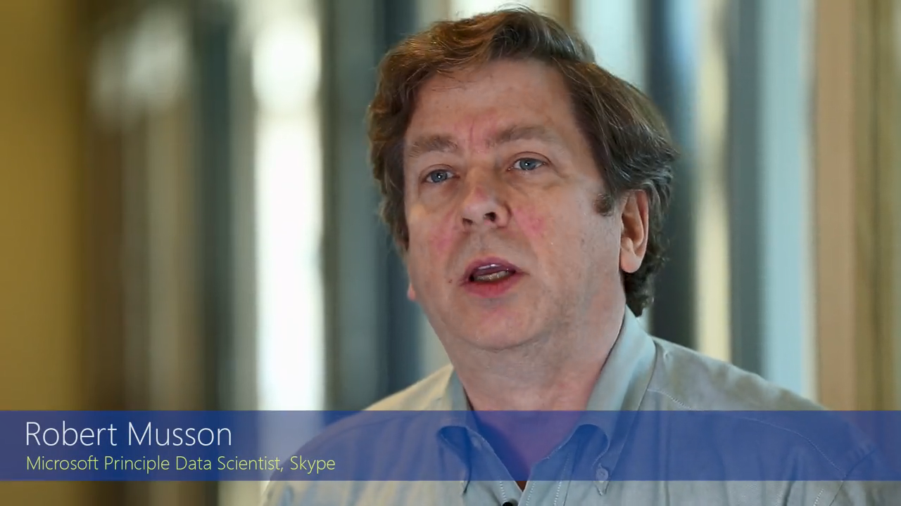
What Data Scientist Do

Slide 10
What Data Scientist Do
Dealing With Data
Raw Data to Transforming Data
Cleaning Data , Good Enough to Trust worthy
Understanding and Preparing Data , Multisource,
Creating Algorithm to create insight

Slide 11
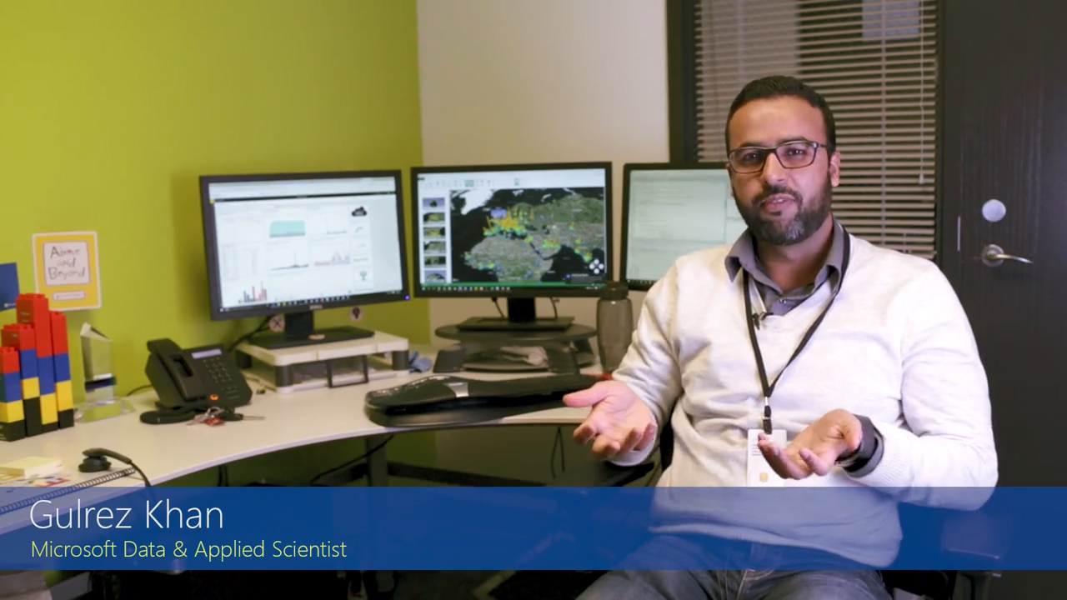
What Kind of Person Succeeds as Data Scientist

Slide 12
What Kind of Person Succeeds as Data Scientist
Little bit Crazy , like data
Love the Data , Dream about data, Creativity
Curious , Work with many individual
Quick learner , ask question … the data
Analyzing the data

Slide 13

What Skills Does a Data Scientist Need

Slide 14
What Skills Does a Data Scientist Need
Statistics
Mathematics
Soft skills
Programing language : R , Python
Excel, Power BI, Tableau, Click and etc
Graphs, Charts

Slide 15
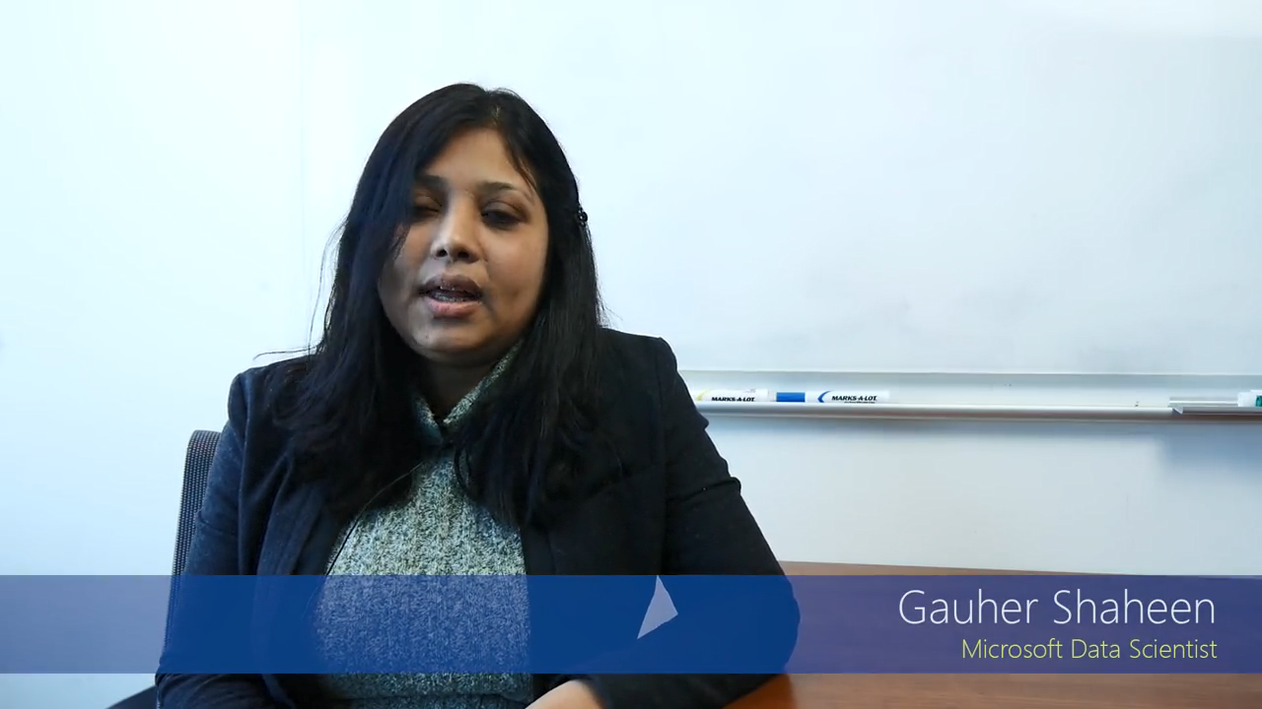
What Advice Would You Give an Aspiring Data Scientist

Slide 16
What Advice Would You Give an Aspiring Data Scientist
Don’t wait , Explore the Data Sets …. Data.gov
Learn from other people and solve some
Seek Problem and share with community
Methodology (There is no right answer from lucky guess )

Slide 17

Question First …
The data may not contain the answer. The combination of some data and an aching desire for an answer does not ensure that a reasonable answer can be extracted from a given body of data - John Tukey

Slide 18
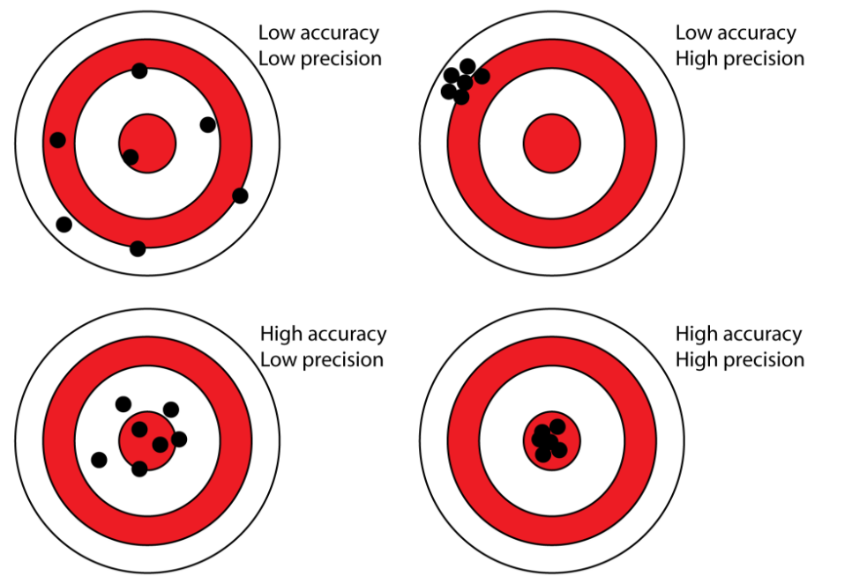
Precision vs Accuracy

Slide 19
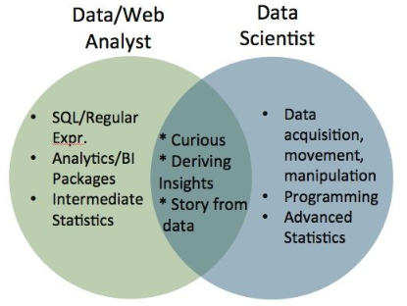
Data Scientist Vs Data Analyst

Slide 20
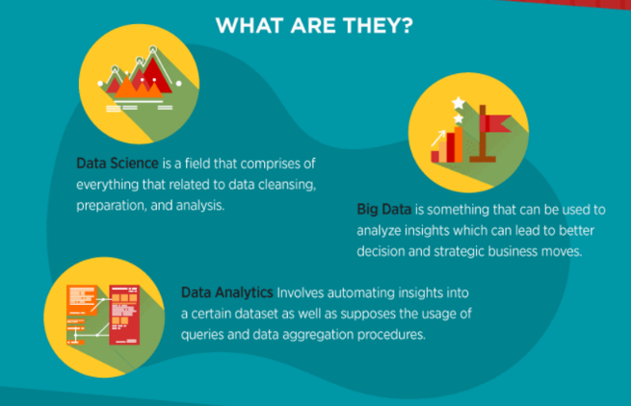
Data Science vs Big Data vs Data Analytics

Slide 21
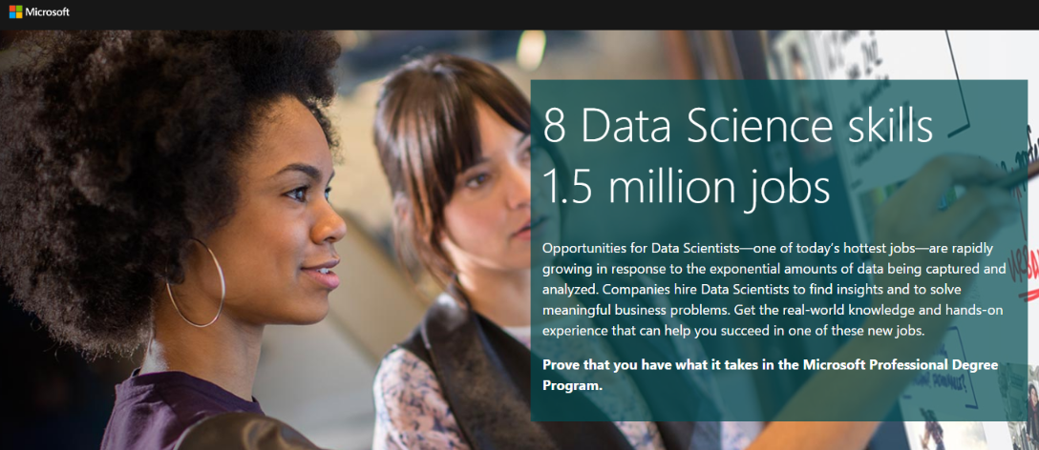
Job Opportunity

Slide 22
8 Skills
Programming Languages – R, Python, SAS
Database – SQL NOSQL
Mathematics – Linear Algebra, Multivariable Calculus
Statistics – Descriptive , Inferential
Data Munging – 80% of time spent on cleaning data
Data Visualization– SQL , NOSQL
Thinking like Data Scientist– Data driven problem solver
Strong Business Acumen – Domain Knowledge

Slide 23
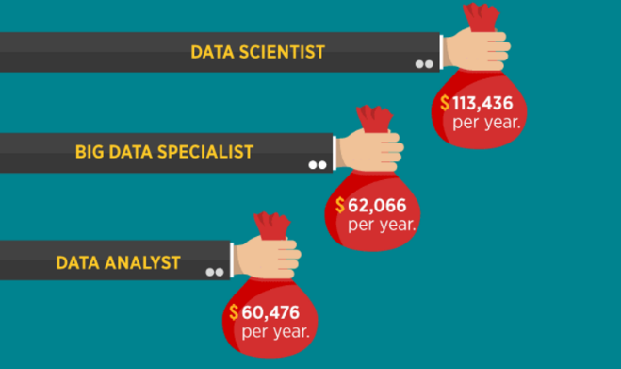
Data Science vs Big Data vs Data Analytics

Slide 24
Few Application Areas
Internet Search
Target Advertisements
Recommender Systems
Image Recognition
Speech Recognition
Gaming
Price Comparison Websites
Airline Route Planning
Fraud and Risk Detection
Delivery Logistics
Self Driving Cars
Robots

Slide 25

Google Analytics In Real Life - Site Search

Slide 26
In Nutshell
If Study of Past and Present is Data Analytics
…. then study of Future is Data Science

Slide 27
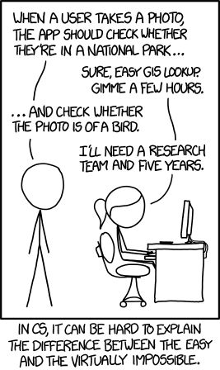
Complexity

Slide 28
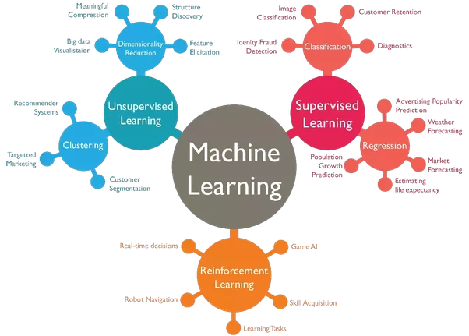
What Next…

Slide 29
Predictive Analytics …
Patient: “Will I survive this risky operation?”
Surgeon: “Yes, I’m absolutely sure that you will survive the operation.”
Patient: “How can you be so sure?”
Surgeon: “9 out of 10 patients die in this operation, and yesterday died my ninth patient.”

Slide 30
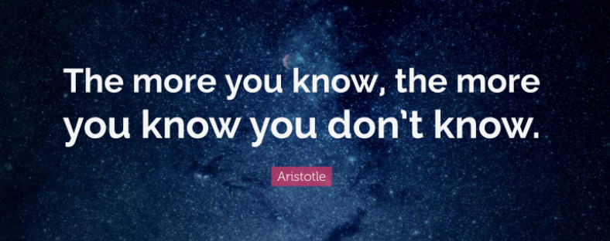
Thank You

